Slide 1
Chapter 6. Classification and Prediction
What is classification? What is prediction?
Issues regarding classification and prediction
Classification by decision tree induction
Bayesian classification ( Naïve Bayes)
Rule-based classification
Classification by back propagation –neural network (MLP)
Support Vector Machines (SVM)
Associative classification
Lazy learners (or learning from your neighbors)
Other classification methods
Prediction
Accuracy and error measures
Ensemble Model selection methods
Summary

Slide 2
Classification vs. Prediction
Classification
predicts categorical class labels (discrete or nominal)
classifies data (constructs a model) based on the training set and the values (class labels) in a classifying attribute and uses it in classifying new data
Prediction (Regression)
models continuous-valued functions, i.e., predicts unknown or missing values
Typical applications
Credit approval
Target marketing
Medical diagnosis
Fraud detection
Notes:
分類
預測分類類標籤（離散或標稱）
根據訓練集和分類屬性中的值（類標籤）對數據進行分類（構建模型），並將其用於對新數據進行分類
預測（回歸）
對連續值函數進行建模，即預測未知值或缺失值
典型應用 信貸審批 目標行銷 醫療診斷 欺詐檢測

Slide 3
Classification—A Two-Step Process
Model construction: describing a set of predetermined classes (construct a training dataset)
Each tuple/sample is assumed to belong to a predefined class, as determined by the class label attribute
The set of tuples used for model construction is training set
The model is represented as classification rules, decision trees, or mathematical formulae
Model usage: for classifying future or unknown objects
Estimate accuracy of the model
The known label of test sample is compared with the classified result from the model
Accuracy rate is the percentage of test samples that are correctly classified by the model
Test set is independent of training set, otherwise over-fitting will occur
If the accuracy is acceptable, use the model to classify data tuples whose class labels are not known
Notes:
模型構建：描述一組預定的類（構建訓練數據集）
假定每個元組/樣本都屬於預定義的類，由類標籤屬性確定
用於模型構建的元組集是訓練集
模型表示為分類規則、決策樹或數學公式
模型用途：用於對未來或未知對象進行分類
估計模型的準確性 將測試樣品的已知標籤與模型的分類結果進行比較
準確率是模型正確分類的測試樣本的百分比
測試集獨立於訓練集，否則會發生過度擬合
如果精度可接受，則使用模型對類標籤未知的數據元組進行分類

Slide 4
Process (1): Model Construction
Classification
Algorithms
Training
Data
Classifier
(Model)
(classification rules)
IF rank = ‘professor’
OR years > 6
THEN tenured = ‘yes’

Slide 5
Process (2): Using the Model in Prediction
Classifier
Testing
Data
Unseen Data
(Jeff, Professor, 4)
Tenured?

Slide 6
Supervised vs. Unsupervised Learning
Supervised learning (classification)
Supervision: Has training data set (observations, measurements, etc.) are accompanied by labels indicating the class of the observations
New data sample is classified based on the training data set
Unsupervised learning (clustering)
No training data set
Given a set of measurements, observations, etc. with the aim of establishing the existence of classes or clusters in the data
Notes:
監督學習（分類） 監督：訓練數據集（觀測值、測量值等）附有指示觀測值類別的標籤 根據訓練數據集對新數據樣本進行分類 無監督學習（聚類） 無訓練數據集 給定一組測量、觀察等，目的是確定數據中是否存在類或聚類

Slide 7
Chapter 6. Classification and Prediction
What is classification? What is prediction?
Issues regarding classification and prediction
Classification by decision tree induction
Bayesian classification
Rule-based classification
Classification by back propagation
Support Vector Machines (SVM)
Associative classification
Lazy learners (or learning from your neighbors)
Other classification methods
Prediction
Accuracy and error measures
Ensemble methods
Model selection
Summary

Slide 8
Issues: Data Preparation
Data cleaning
Preprocess data in order to reduce noise and handle missing values
Relevance analysis (feature selection)
Remove the irrelevant or redundant attributes
Data transformation
Generalize and/or normalize data

Slide 9
Issues: Evaluating Classification Methods
Accuracy
classifier accuracy: predicting class label
predictor accuracy: guessing value of predicted attributes
Speed
time to construct the model (training time)
time to use the model (classification/prediction time)
Robustness: handling noise and missing values
Scalability: Big data
Interpretability
understanding and insight provided by the model
Other measures, e.g., goodness of rules, such as decision tree size or compactness of classification rules
Notes:
準確性 分類器準確性：預測類標籤 預測變數準確性：預測屬性的猜測值 速度 建譯模型的時間（訓練時間） 使用模型的時間（分類/預測時間） 魯棒性/堅耐性：處理雜訊和缺失值 可擴展性：大數據 可解釋性 模型提供的理解和見解 其他度量，例如規則的優度，例如決策樹大小或分類規則的緊湊性

Slide 10
Chapter 6. Classification and Prediction
What is classification? What is prediction?
Issues regarding classification and prediction
Classification by decision tree induction
Bayesian classification
Rule-based classification
Classification by back propagation
Support Vector Machines (SVM)
Associative classification
Lazy learners (or learning from your neighbors)
Other classification methods
Prediction
Accuracy and error measures
Ensemble methods
Model selection
Summary

Slide 11
Decision Tree Induction: Training Dataset
This follows an example of Quinlan’s ID3 (originally, Sunday morning)

Slide 12
Output: A Decision Tree for “buys_computer”
age?
<=30
overcast
>40
31..40
student?
yes
credit rating?
no
yes
excellent
fair
no
yes
no
yes

Slide 13
Algorithm for Decision Tree Induction
Basic algorithm (a greedy algorithm)
Tree is constructed in a top-down recursive divide-and-conquer manner
At start, all the training examples are at the root
Attributes are categorical (if continuous-valued, they are discretized in advance)
Examples are partitioned recursively based on selected attributes
Test attributes are selected based on a heuristic or statistical measure (e.g., information gain)
Conditions for stopping partitioning
All samples for a given node belong to the same class
There are no remaining attributes for further partitioning – majority voting is employed for classifying the leaf node
There are no samples left
Notes:
基本演算法（貪婪演算法） 樹以自上而下的遞歸分而治之的方式構造 一開始，所有的訓練示例都在根部 屬性是分類的（如果連續值，則提前離散化） 示例根據所選屬性遞歸分區 根據啟發式或統計度量（例如，資訊增益）選擇測試屬性 停止分區的條件 給定節點的所有樣本都屬於同一類 沒有剩餘的屬性用於進一步分區 - 多數投票用於對葉節點進行分類 沒有樣品了

Slide 14
Which attribute is better?
Attribute
1
Attribute
2
The purer the better!
Notes:
I : the expected information needed to classify a given sample
E (entropy) : expected information based on the partitioning into subsets by A

Slide 15
Attribute Selection Measure: Information Gain (ID3/C4.5)
Select the attribute with the highest information gain
Let p_{i} be the probability that an arbitrary tuple in D belongs to class C_{i}, estimated by |C_{i, D}|/|D|
The entropy of node D:
The entropy after split:
Weighted sum of node’s impurity
Information gained by branching on attribute A
Notes:
選擇資訊增益最高的屬性
設 pi 為 D 中任意元組屬於類 Ci 的概率，估計公式為 |Ci， D|/|D|
節點 D 的熵：
分裂后的熵：
節點雜質的加權和，
通過對屬性 A 進行分支獲得的資訊

Slide 16
Attribute Selection: Information Gain
Class P: buys_computer = “yes”
Class N: buys_computer = “no”
means “age <=30” has 5 out of 14 samples, with 2 yes’es and 3 no’s. Hence
Similarly,

Slide 17
Computing Information-Gain for Continuous-Value Attributes
Let attribute A be a continuous-valued attribute
Must determine the best split point for A
Sort the value A in increasing order
Typically, the midpoint between each pair of adjacent values is considered as a possible split point
(a_{i}+a_{i+1})/2 is the midpoint between the values of a_{i} and a_{i+1}
The point with the minimum expected information requirement for A is selected as the split-point for A
Split:
D1 is the set of tuples in D satisfying A ≤ split-point, and D2 is the set of tuples in D satisfying A > split-point

Slide 18
Gain Ratio for Attribute Selection (C4.5)
Information gain measure is biased towards attributes with a large number of values
C4.5 (a successor of ID3) uses gain ratio to overcome the problem (normalization to information gain)
GainRatio(A) = Gain(A)/SplitInfo(A)
Ex.
gain_ratio(income) = 0.029/0.926 = 0.031
The attribute with the maximum gain ratio is selected as the splitting attribute

Slide 19
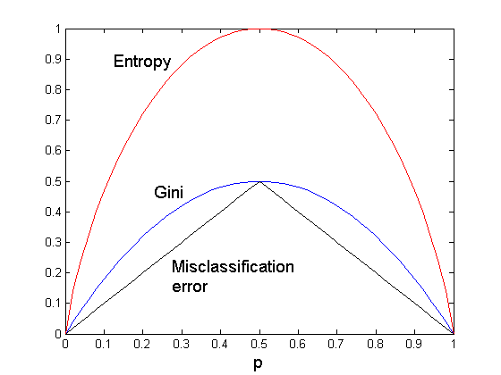
Comparison among Splitting Criteria
For a 2-class problem: t is a node (data set) and we have c (=2, here) different class labels, p is the probability of class 1.
Entropy(t)=
Gini(t)=1-
Classification error(t)=

Slide 20
Gini index (CART, IBM IntelligentMiner)
If a data set D contains examples from n classes, gini index, gini(D) is defined as
where p_{j} is the relative frequency of class j in D
If a data set D is split on A into two subsets D₁ and D₂, the gini index gini(D) is defined as
Reduction in Impurity:
The attribute provides the smallest gini_{split}(D) (or the largest reduction in impurity) is chosen to split the node (need to enumerate all the possible splitting points for each attribute)

Slide 21
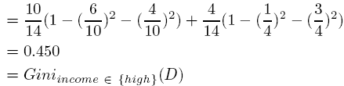
Gini index (CART, IBM IntelligentMiner)
Ex. D has 9 tuples in buys_computer = “yes” and 5 in “no”
Suppose the attribute income partitions D into 10 in D₁: {low, medium} and 4 in D₂
but gini_{{medium,high}} is 0.30 and thus the best since it is the lowest
All attributes are assumed continuous-valued
May need other tools, e.g., clustering, to get the possible split values
Can be modified for categorical attributes

Slide 22
Decision Tree Induction: Training Dataset
This follows an example of Quinlan’s ID3 (originally, Sunday morning)

Slide 23
Comparing Attribute Selection Measures
The three measures, in general, return good results but
Information gain:
biased towards multivalued attributes
Gain ratio:
tends to prefer unbalanced splits in which one partition is much smaller than the others
Gini index:
biased to multivalued attributes
has difficulty when # of classes is large
tends to favor tests that result in equal-sized partitions and purity in both partitions
Notes:
一般來說，這三個度量返回了良好的結果，但資訊增益：偏向於多值屬性 增益比：傾向於偏愛不平衡的拆分，其中一個分區比其他分區小得多 基尼指數：偏向於多值屬性在類 # 很大時有困難 傾向於支持導致兩個分區大小和純度相等的分區的測試

Slide 24
Other Attribute Selection Measures
CHAID: a popular decision tree algorithm, measure based on χ² test for independence
C-SEP: performs better than info. gain and gini index in certain cases
G-statistics: has a close approximation to χ² distribution
MDL (Minimal Description Length) principle (i.e., the simplest solution is preferred):
The best tree as the one that requires the fewest # of bits to both (1) encode the tree, and (2) encode the exceptions to the tree
Multivariate splits (partition based on multiple variable combinations)
CART: finds multivariate splits based on a linear comb. of attrs.
Which attribute selection measure is the best?
Most give good results, none is significantly superior than others

Slide 25
Overfitting and Tree Pruning
Overfitting: An induced tree may overfit the training data
Too many branches, some may reflect anomalies due to noise or outliers
Poor accuracy for unseen samples
Two approaches to avoid overfitting
Prepruning: Halt tree construction early—do not split a node if this would result in the goodness measure falling below a threshold
Difficult to choose an appropriate threshold
Postpruning: Remove branches from a “fully grown” tree—get a sequence of progressively pruned trees
Use a set of data different from the training data to decide which is the “best pruned tree”
Notes:
避免過度擬合的兩種方法 準備修剪：儘早停止樹的構建 - 如果會導致優度度量低於閾值，請不要拆分節點 難以選擇合適的閾值 延遲修剪：從“完全生長”的樹中刪除分支 - 獲取一系列逐步修剪的樹 使用一組不同於訓練數據的數據來確定哪個是「最佳修剪樹」

Slide 26
Enhancements to Basic Decision Tree Induction
Allow for continuous-valued attributes
Dynamically define new discrete-valued attributes that partition the continuous attribute value into a discrete set of intervals
Handle missing attribute values
Assign the most common value of the attribute
Assign probability to each of the possible values
Attribute construction
Create new attributes based on existing ones that are sparsely represented
This reduces fragmentation, repetition, and replication

Slide 27
Chapter 6. Classification and Prediction
What is classification? What is prediction?
Issues regarding classification and prediction
Classification by decision tree induction
Bayesian classification
Rule-based classification
Classification by back propagation
Support Vector Machines (SVM)
Associative classification
Lazy learners (or learning from your neighbors)
Other classification methods
Prediction
Accuracy and error measures
Ensemble methods
Model selection
Summary

Slide 28
Bayesian Classification: Why?
A statistical classifier: performs probabilistic prediction, i.e., predicts class membership probabilities
Foundation: Based on Bayes’ Theorem.
Performance: A simple Bayesian classifier, naïve Bayesian classifier, has comparable performance with decision tree and selected neural network classifiers
Incremental: Each training example can incrementally increase/decrease the probability that a hypothesis is correct — prior knowledge can be combined with observed data
Standard: Even when Bayesian methods are computationally intractable, they can provide a standard of optimal decision making against which other methods can be measured

Slide 29
Bayesian Theorem: Basics
Let X be a data sample (“evidence”): class label is unknown
Let H be a hypothesis that “X belongs to class C”
Classification is to determine P(H|X), the probability that the hypothesis holds given the observed data sample X
P(H) (prior probability), the initial probability
E.g., X will buy computer, regardless of age, income, …
P(X): probability that sample data is observed
P(X|H) (posteriori probability, cond. Prob.), the probability of observing the sample X, given that the hypothesis holds
E.g., Given that X will buy computer, the prob. that X is 31..40, medium income

Slide 30
Bayesian Theorem
Given training data X, posteriori probability of a hypothesis H, P(H|X), follows the Bayes theorem
Informally, this can be written as
posteriori = likelihood x prior/evidence
Principle: Predicts that X belongs to C₂ iff the probability P(C₂|X) is the highest among all the P(C_{k}|X) for all the k classes
MAP: Maximize a posteriori
p(X) is the normalizing factor

Slide 31
Towards Naïve Bayesian Classifier
Let D be a training set of tuples and their associated class labels, and each tuple is represented by an n-D attribute vector X = (x₁, x₂, …, x_{n})
Suppose there are m classes C₁, C₂, …, C_{m}.
Classification is to derive the maximum posteriori, i.e., the maximal P(C_{i}|X)
This can be derived from Bayes’ theorem
Since P(X) is constant for all classes, only
needs to be maximized

Slide 32
Derivation of Naïve Bayes Classifier
A simplified assumption: attributes are conditionally independent (i.e., no dependence relation between attributes):
This greatly reduces the computation cost: Only counts the class distribution
If A_{k} is categorical, P(x_{k}|C_{i}) is the # of tuples in C_{i} having value x_{k} for A_{k} divided by |C_{i, D}| (# of tuples of C_{i} in D)
If A_{k} is continous-valued, P(x_{k}|C_{i}) is usually computed based on Gaussian distribution with a mean μ and standard deviation σ
and P(x_{k}|C_{i}) is

Slide 33
Naïve Bayesian Classifier: Training Dataset
Class:
C1:buys_computer = ‘yes’
C2:buys_computer = ‘no’
Data sample
X = (age <=30,
Income = medium,
Student = yes
Credit_rating = Fair)

Slide 34
Naïve Bayesian Classifier: An Example
P(C_{i}): P(buys_computer = “yes”) = 9/14 = 0.643
P(buys_computer = “no”) = 5/14= 0.357
Compute P(X|C_{i}) for each class
P(age = “<=30” | buys_computer = “yes”) = 2/9 = 0.222
P(age = “<= 30” | buys_computer = “no”) = 3/5 = 0.6
P(income = “medium” | buys_computer = “yes”) = 4/9 = 0.444
P(income = “medium” | buys_computer = “no”) = 2/5 = 0.4
P(student = “yes” | buys_computer = “yes) = 6/9 = 0.667
P(student = “yes” | buys_computer = “no”) = 1/5 = 0.2
P(credit_rating = “fair” | buys_computer = “yes”) = 6/9 = 0.667
P(credit_rating = “fair” | buys_computer = “no”) = 2/5 = 0.4
X = (age <= 30 , income = medium, student = yes, credit_rating = fair)
P(X|C_{i}) : P(X|buys_computer = “yes”) = 0.222 x 0.444 x 0.667 x 0.667 = 0.044
P(X|buys_computer = “no”) = 0.6 x 0.4 x 0.2 x 0.4 = 0.019
P(X|C_{i})*P(C_{i}) : P(X|buys_computer = “yes”) * P(buys_computer = “yes”) = 0.028
P(X|buys_computer = “no”) * P(buys_computer = “no”) = 0.007
Therefore, X belongs to class (“buys_computer = yes”)

Slide 35
Avoiding the 0-Probability Problem
Naïve Bayesian prediction requires each conditional prob. be non-zero. Otherwise, the predicted prob. will be zero
Ex. Suppose a dataset with 1000 tuples, income=low (0), income= medium (990), and income = high (10),
Use Laplacian correction (or Laplacian estimator)
Adding 1 to each case
Prob(income = low) = 1/1003
Prob(income = medium) = 991/1003
Prob(income = high) = 11/1003
The “corrected” prob. estimates are close to their “uncorrected” counterparts

Slide 36
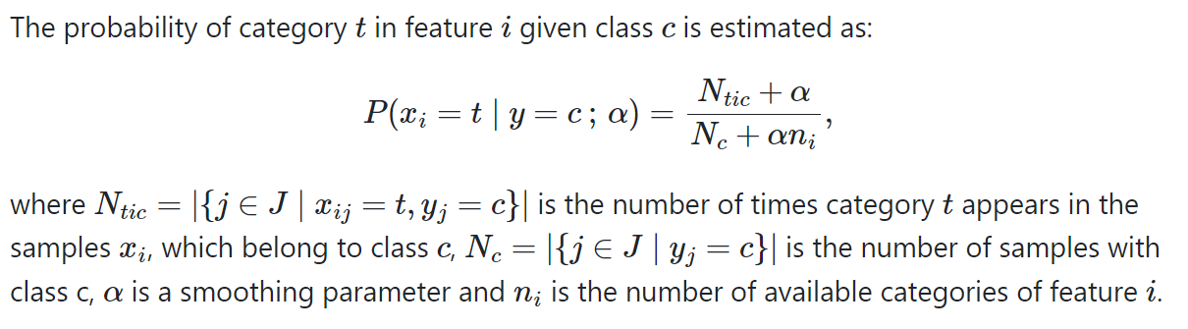

Slide 37
Laplacian estimator
Laplace-k smoothed correction
Given: a1, a2, a1, a2, a3, a1, a3, a2
Asked: Laplace-k smoothed of P(A) with domain of A={a1, a2, a3) for k=0, 1, 2
k=0 :
P(A=a1) = 3/8; P(A=a2)= 3/8; P(A=a3) = 2/8
k=1: add 1 for every different value
P(A=a1) = (3+1)/(8+3)= 4/11;
For k=c
P(A=a1) = (3+c)/(8+3c); 3c because of 3 different values

Slide 38
Naïve Bayesian Classifier: Comments
Advantages
Easy to implement
Good results obtained in most of the cases
Disadvantages
Assumption: class conditional independence, therefore loss of accuracy
Practically, dependencies exist among variables
E.g., hospitals: patients: Profile: age, family history, etc.
Symptoms: fever, cough etc., Disease: lung cancer, diabetes, etc.
Dependencies among these cannot be modeled by Naïve Bayesian Classifier
How to deal with these dependencies?
Bayesian Belief Networks

Slide 39
Bayesian Belief Networks
Bayesian belief network allows a subset of the variables conditionally independent
A graphical model of causal relationships
Represents dependency among the variables
Gives a specification of joint probability distribution
Nodes: random variables
Links: dependency
X and Y are the parents of Z, and Y is the parent of P
No dependency between Z and P
Has no loops or cycles
X
Y
Z
P

Slide 40
Bayesian Belief Network: An Example
Family
History
Smoker
The conditional probability table (CPT) for variable LungCancer:
(FH, S)
(FH, ~S)
(~FH, S)
(~FH, ~S)
LC
0.8
0.5
0.7
0.1
LungCancer
Emphysema
~LC
0.2
0.5
0.3
0.9
CPT shows the conditional probability for each possible combination of its parents
PositiveXRay
Dyspnea
Derive a probability for a particular combination of values of X, from CPT:
Bayesian Belief Networks

Slide 41
Training Bayesian Networks
Several scenarios:
Given both the network structure and all variables observable: learn only the CPTs
Network structure known, some hidden variables: gradient descent (greedy hill-climbing) method, analogous to neural network learning
Network structure unknown, all variables observable: search through the model space to reconstruct network topology
Unknown structure, all hidden variables: No good algorithms known for this purpose
Ref. D. Heckerman: Bayesian networks for data mining

Slide 42
Chapter 6. Classification and Prediction
What is classification? What is prediction?
Issues regarding classification and prediction
Classification by decision tree induction
Bayesian classification
Rule-based classification
Classification by back propagation
Support Vector Machines (SVM)
Associative classification
Lazy learners (or learning from your neighbors)
Other classification methods
Prediction
Accuracy and error measures
Ensemble methods
Model selection
Summary

Slide 43
Neural Network as a Classifier
Weakness
Long training time
Require a number of parameters typically best determined empirically, e.g., the network topology or ``structure."
Poor interpretability: Difficult to interpret the symbolic meaning behind the learned weights and of ``hidden units" in the network
Strength
High tolerance to noisy data
Ability to classify untrained patterns
Well-suited for continuous-valued inputs and outputs
Successful on a wide array of real-world data
Algorithms are inherently parallel
Techniques have recently been developed for the extraction of rules from trained neural networks
Notes:
弱點 訓練時間長 需要許多通常最好根據經驗確定的參數，例如，網路拓撲或“結構”。 可解釋性差：難以解釋網路中學習權重和「隱藏單位」背後的象徵意義 強度 對嘈雜數據的高耐受性 能夠對未經訓練的模式進行分類 非常適合連續值輸入和輸出 成功處理各種真實數據 演算法本質上是並行的 最近開發了從經過訓練的神經網路中提取規則的技術

Slide 44
Classification by Backpropagation
Backpropagation: A neural network learning algorithm
Started by psychologists and neurobiologists to develop and test computational analogues of neurons
A neural network: A set of connected input/output units where each connection has a weight associated with it
During the learning phase, the network learns by adjusting the weights so as to be able to predict the correct class label of the input tuples
Also referred to as connectionist learning due to the connections between units

Slide 45
Artificial Neural Network
Hidden
Input
Output
1. Activation function
2. Weights
3. Cost function
4. Learning algorithm

Slide 46
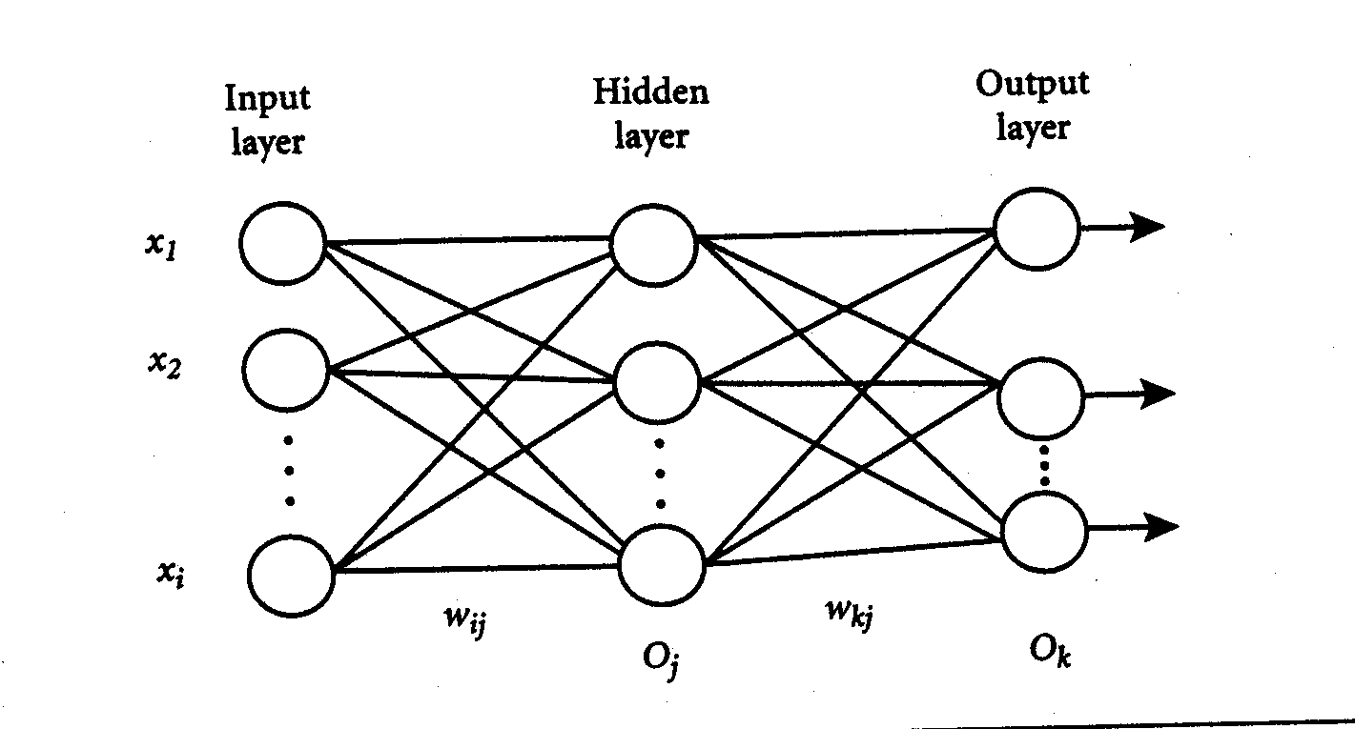
1. Activation function
2. Weights
3. Cost function
4. Learning algorithm

Slide 47
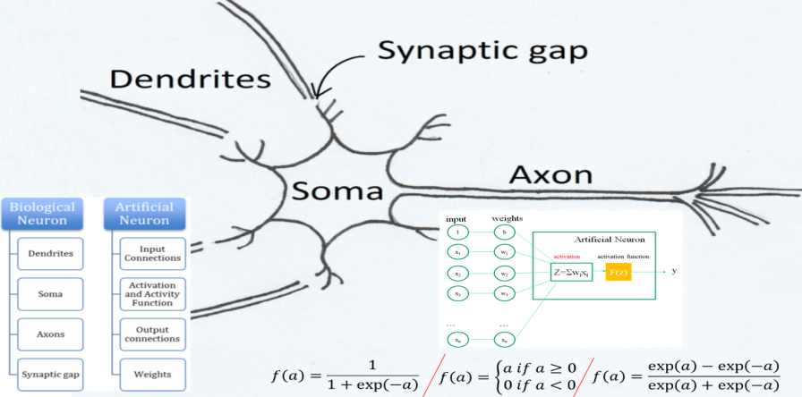



Neural network
Dentrite-樹突
Cell body(Soma)-細胞體
Axons-軸突
Synaptic gap-突觸間隙
ReLU
(Rectifier, or Rectified Linear Unit)
一個神經元(感知器)
perceptron
Sigmod
Hyperbolic tangent
Notes:
神經元（Neurons）是生物神經系統的結構單位，其功能是用於感知環境變化，再將查覺到的訊息傳給其他神經元後做出集體反應。一個神經元的各部位的功能：
樹突（Dendrites）：用來接收其他神經元的訊號
細胞體（Soma）：是神經元主要結構，用於處理感知到的訊息
軸突（Axon）: 傳輸此神經元的動作電位（可說是這個 Neuron 的 output）
突觸（Synapse）: 用來連接其他神經元的接頭
基本上單個細胞的運作是這樣的：先從樹突（Dendrites）接收其他細胞傳來的資訊，透過細胞體（Soma）處理資訊再透過軸突（Axon）傳給突觸（Synapse）之後傳遞給其他細胞。
而人類透過一些實驗才了解，生物神經系統是透過無數個細胞相連，並在接收到外界刺激之後迅速作出反應，這個過程對應到數學上來說，是非常高維度的平行運算。

Slide 48
A Neuron (= a perceptron)
-
μ_{k}
x₀
w₀
x₁
w₁
∑
f
output y
x_{n}
w_{n}
Input
vector x
weight
vector w
weighted
sum
Activation
function
The n-dimensional input vector x is mapped into variable y by means of the scalar product and a nonlinear function mapping

Slide 49
Network Training
The ultimate objective of training
obtain a set of weights that makes almost all the tuples in the training data classified correctly
Steps
Initialize weights with random values
Feed the input tuples into the network one by one
For each unit
Compute the net input to the unit as a linear combination of all the inputs to the unit
Compute the output value using the activation function
Compute the error
Update the weights and the bias
Notes:
培訓的最終目的
獲得一組權重，使訓練資料中的幾乎所有元組都能正確分類
腳步
使用隨機值初始化權重
將輸入元組一一送入網絡
對於每個單位
將單元的淨輸入計算為單元所有輸入的線性組合
使用激活函數計算輸出值
計算誤差
更新權重和偏差

Slide 50
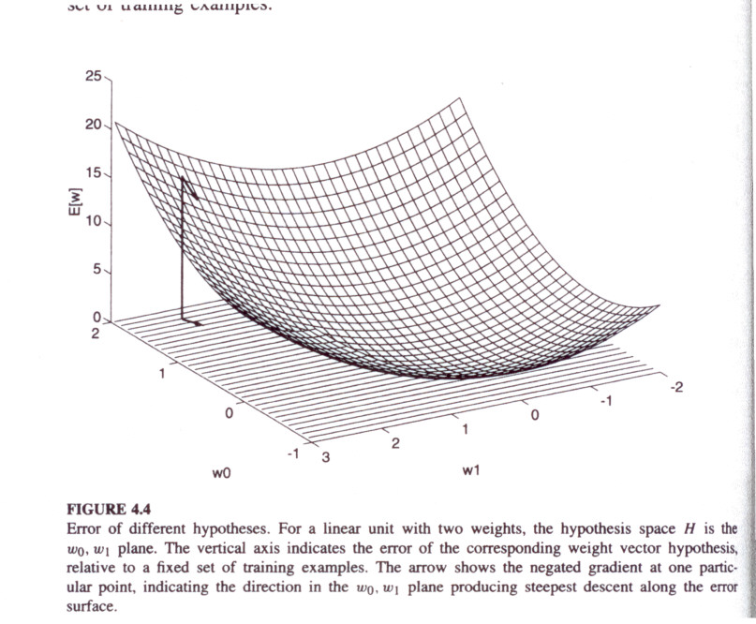
Gradient Descent Rule

Slide 51
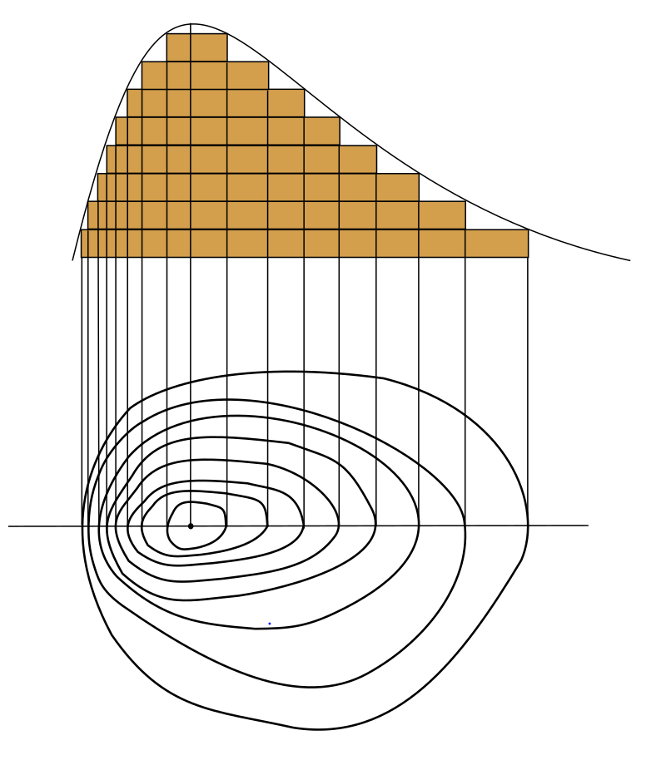
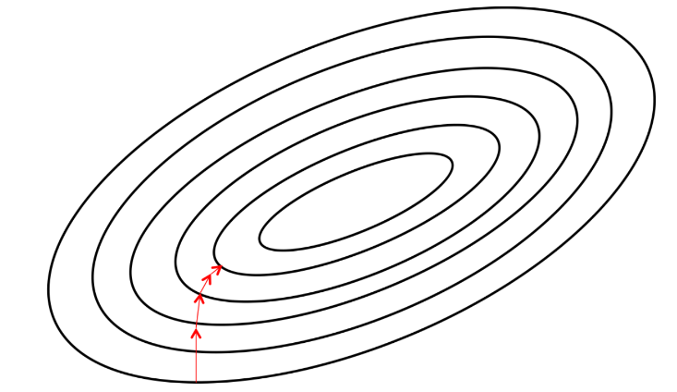
等高線(Level curve, or Contour map)

Slide 52
Gradient (Ascent or descent?)
Let’s start with a simple one!
f(x, y)=x + y
Given x = a, y = b, how to update x and y to make f(x, y) larger?
Follow gradient directions!
f(x, y)= x + y
x= a + 0.01 * 1,
y= b + 0.01 * 1 (a, b) + 0.01 * (1, 1)
f(x, y): a+b a+b+0.02
Step size
Notes:
他在F(X,Y)先對XY分別作為分得到1(兩者皆) 但下面xy他是帶入a+0.01*1 這邊的帶入是
他自己設定的還是權重(前面提到的W權重) 然後後面變成(a,b)+0.01(1,1)這邊不太明白>< {他從變數變成多為度變量?}
0.01應該是步長 η學習率

Slide 53
A more complex one!
f(x, y)=x * y
Given x = a, y = b, how to update x and y to make f(x, y) larger?
Follow gradient directions!
f(x, y)= xy
x= a + 0.01 * b,
y= b + 0.01 * a
f(x, y): a*b ( a+0.01*b)*(b+0.01*a)
f(x,y):4*(-3) 3.97*(-2.96) =-11.7512

Slide 54
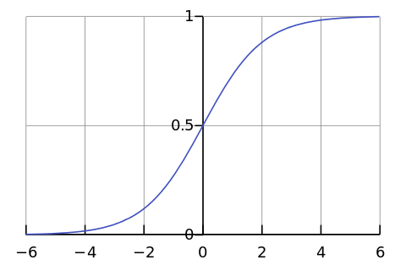

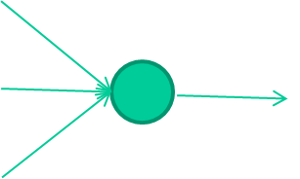
-0.06
W1
W2
f(x)
-2.5
W3
1.4

Slide 55

-0.06
2.7
-8.6
f(x)
-2.5
0.002
x = -0.06×2.7 + 2.5×8.6 + 1.4×0.002 = 21.34
1.4
output$=\frac{1}{1+e^{−21.34}}=0.999$

Slide 56
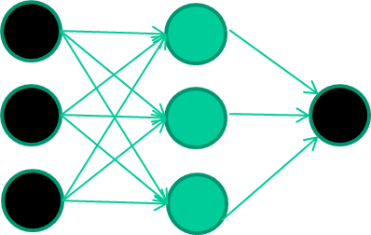
A dataset
Fields class
1.4 2.7 1.9 0
3.8 3.4 3.2 0
6.4 2.8 1.7 1
4.1 0.1 0.2 0
etc …

Slide 57
Training the neural network
Fields class
1.4 2.7 1.9 0
3.8 3.4 3.2 0
6.4 2.8 1.7 1
4.1 0.1 0.2 0
etc …

Slide 58
Training data
Fields class
1.4 2.7 1.9 0
3.8 3.4 3.2 0
6.4 2.8 1.7 1
4.1 0.1 0.2 0
etc …
Initialise with random weights

Slide 59
Training data
Fields class
1.4 2.7 1.9 0
3.8 3.4 3.2 0
6.4 2.8 1.7 1
4.1 0.1 0.2 0
etc …
Present a training pattern
1.4
2.7
1.9

Slide 60
Training data
Fields class
1.4 2.7 1.9 0
3.8 3.4 3.2 0
6.4 2.8 1.7 1
4.1 0.1 0.2 0
etc …
Feed it through to get output
1.4
2.7 0.8
1.9

Slide 61
Training data
Fields class
1.4 2.7 1.9 0
3.8 3.4 3.2 0
6.4 2.8 1.7 1
4.1 0.1 0.2 0
etc …
Compare with target output
1.4
2.7 0.8
0
1.9 error 0.8

Slide 62


Training data
Fields class
1.4 2.7 1.9 0
3.8 3.4 3.2 0
6.4 2.8 1.7 1
4.1 0.1 0.2 0
etc …
Adjust weights based on error
1.4
2.7 0.8
0
1.9 error 0.8

Slide 63
Training data
Fields class
1.4 2.7 1.9 0
3.8 3.4 3.2 0
6.4 2.8 1.7 1
4.1 0.1 0.2 0
etc …
Present a training pattern
6.4
2.8
1.7

Slide 64
Training data
Fields class
1.4 2.7 1.9 0
3.8 3.4 3.2 0
6.4 2.8 1.7 1
4.1 0.1 0.2 0
etc …
Feed it through to get output
6.4
2.8 0.9
1.7

Slide 65
Training data
Fields class
1.4 2.7 1.9 0
3.8 3.4 3.2 0
6.4 2.8 1.7 1
4.1 0.1 0.2 0
etc …
Compare with target output
6.4
2.8 0.9
1
1.7 error -0.1

Slide 66
Training data
Fields class
1.4 2.7 1.9 0
3.8 3.4 3.2 0
6.4 2.8 1.7 1
4.1 0.1 0.2 0
etc …
Adjust weights based on error
6.4
2.8 0.9
1
1.7 error -0.1

Slide 67
Training data
Fields class
1.4 2.7 1.9 0
3.8 3.4 3.2 0
6.4 2.8 1.7 1
4.1 0.1 0.2 0
etc …
And so on ….
6.4
2.8 0.9
1
1.7 error -0.1
Repeat this thousands, maybe millions of times – each time
taking a random training instance, and making slight
weight adjustments
Algorithms for weight adjustment are designed to make
changes that will reduce the error

Slide 68
The decision boundary perspective…
Initial random weights

Slide 69
The decision boundary perspective…
Present a training instance / adjust the weights

Slide 70
The decision boundary perspective…
Present a training instance / adjust the weights

Slide 71
The decision boundary perspective…
Present a training instance / adjust the weights

Slide 72
The decision boundary perspective…
Present a training instance / adjust the weights

Slide 73
The decision boundary perspective…
Eventually ….

Slide 74
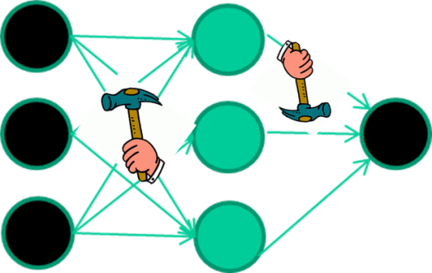
The point I am trying to make
they work by making thousands and thousands of tiny adjustments, each making the network do better at the most recent pattern, but perhaps a little worse on many others
but, by dumb luck, eventually this tends to be good enough to learn effective classifiers for many real applications
Notes:
它們通過進行成千上萬次微小的調整來工作，每個調整都使網路在最近的模式中做得更好，但在許多其他模式上可能更糟 但是，運氣不好，最終這往往足以學習許多實際應用程式的有效分類器

Slide 75
The details

Slide 76
Multi-Layer Perceptron (MLP)
Output vector
Output nodes
Hidden nodes
w_{ij}
Input nodes
Input vector: x_{i}

Slide 77
The vector derivative called the gradient of E with respect to w is written as ∇E(w), ∇: nabla, or grad
The gradient specifies the direction that produces the steepest increase in E.
The negative of this vector gives the direction of the steepest decrement rate of loss function (gradient descent)
http://www.uefap.com/speaking/symbols/symbols.htm

Slide 78
The (updating) training rule for gradient descent is
where
, a small step along the opposite direction of the gradient
For component w_{i} ,
w_{i}←w_{i} + Δw_{i,} and Δw_{i}=

Slide 79
η is a positive constant called the learning rate, which determines the step size in the gradient descent search.
Usually, the error function E_{d}(w) for each individual training example d is defined as follows

Slide 80
Backpropagation rule
Updating weight w_{ij} by adding to it Δw_{ji}, for training example d. w_{ij} –代表i節點到j節點的權重(from i to j)
E_{d} is the error on training example d (一個樣本), summed over all output units in the network.
Outputs is the set of output units in the network, t_{k} is the target value of unit k for training example d, and o_{k} is the output of unit k given training example d. Only o_{k} is a function of w

Slide 81
Notations
subscript j denotes the jth unit of the network
x_{ij}=the i^{th} input to unit j (node i to node j)
w_{ij}= the weight associated with the i^{th} input to unit j
net_{j}=∑_{i} w_{ij} x_{ij} ( the weighted sum of inputs for unit j)
o_{j}= the output computed by unit j
t_{j}= the target output for unit j
σ= the sigmod function
outputs= the set of units in the final layer of the network
Downstream(j) = the set of units whose immediate inputs include the output of unit j (nodes directly after j)

Slide 82
Weight w_{ji} can influence the rest of the network only through net_{j}. Therefore, use Chain Rule to write
j is an output node
i
W_{ij}
j
k

Slide 83
Updates on the last layer
Case 1: Training Rule for output unit weights
net_{j} can influence the network only through o_{j}, therefore,

Slide 84
Since o_{j} = σ(net_{j}), therefore
We have,
Finally, put together, we have:

Slide 85
Case 2: Training rule for Hidden Unit Weights.
Node j is an internal, or hidden unit in the network.
To derive the training rule for w_{ij} , one must take into account the indirect ways in which w_{ij} can influence the network outputs and hence E_{d}.
Define Downstream(j) to the set of all units immediately downstream of unit j in the network.
That is, the units whose direct inputs include the output of unit j.

Slide 86
Multivariable chain rule:
i
w_{ij}
j
o_{j}
k
k is an output
δ_{k} denote (- )
Adjusted error of node k

Slide 87
Let δ_{j} denote (- ) , we have
The errors (gradients of loss func.) contributed by next layer
Note that

Slide 88
Multi-Layer Perceptron (MLP)
Output vector
Output nodes
Hidden nodes
w_{ij}
Input nodes
Input vector: x_{i}

Slide 89
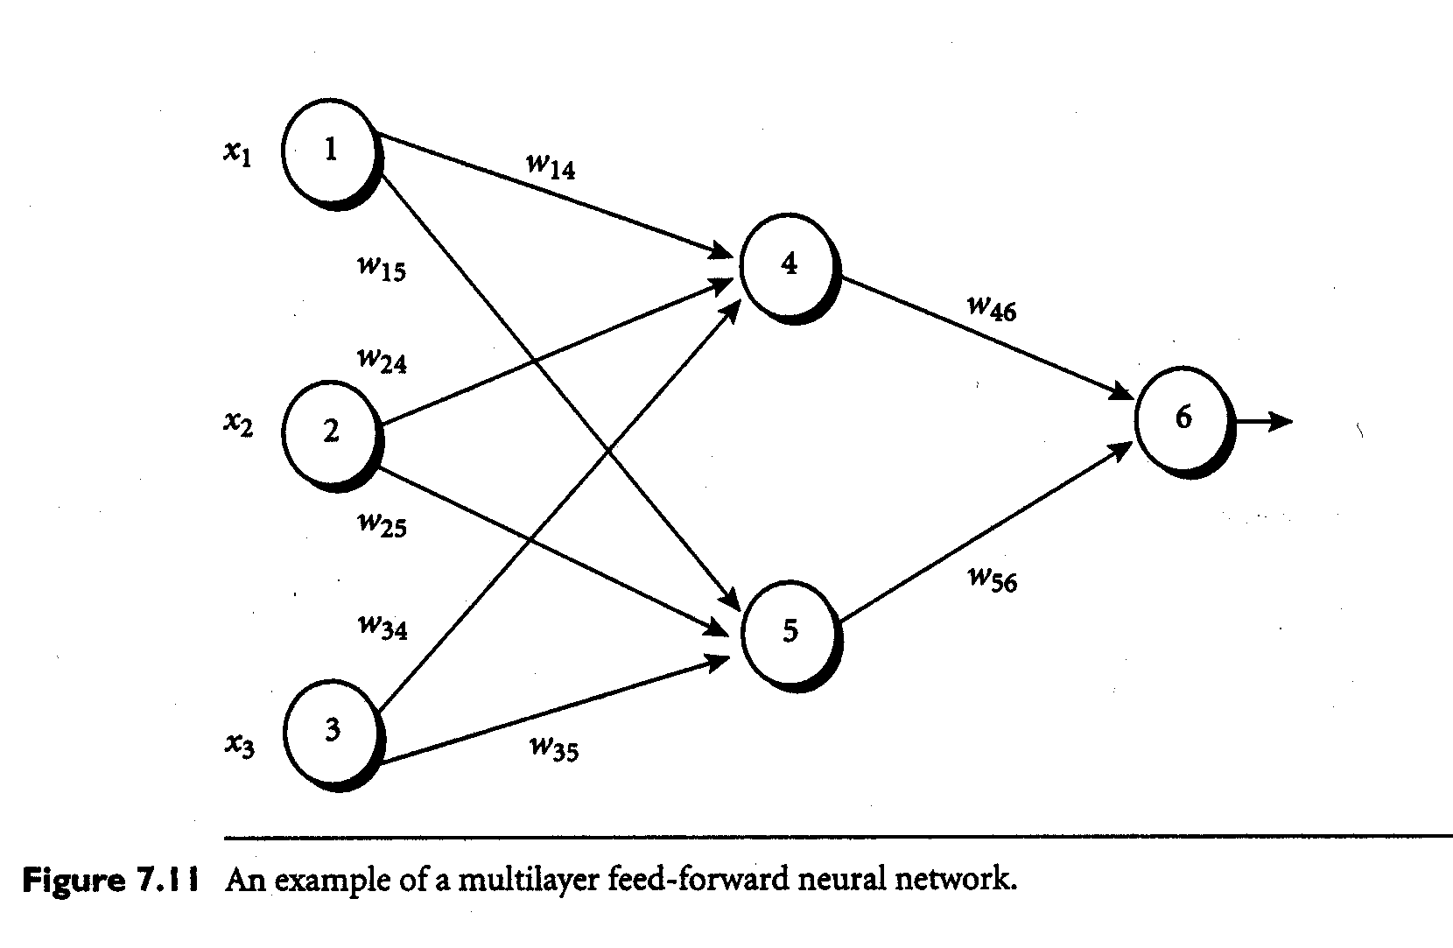

Slide 90
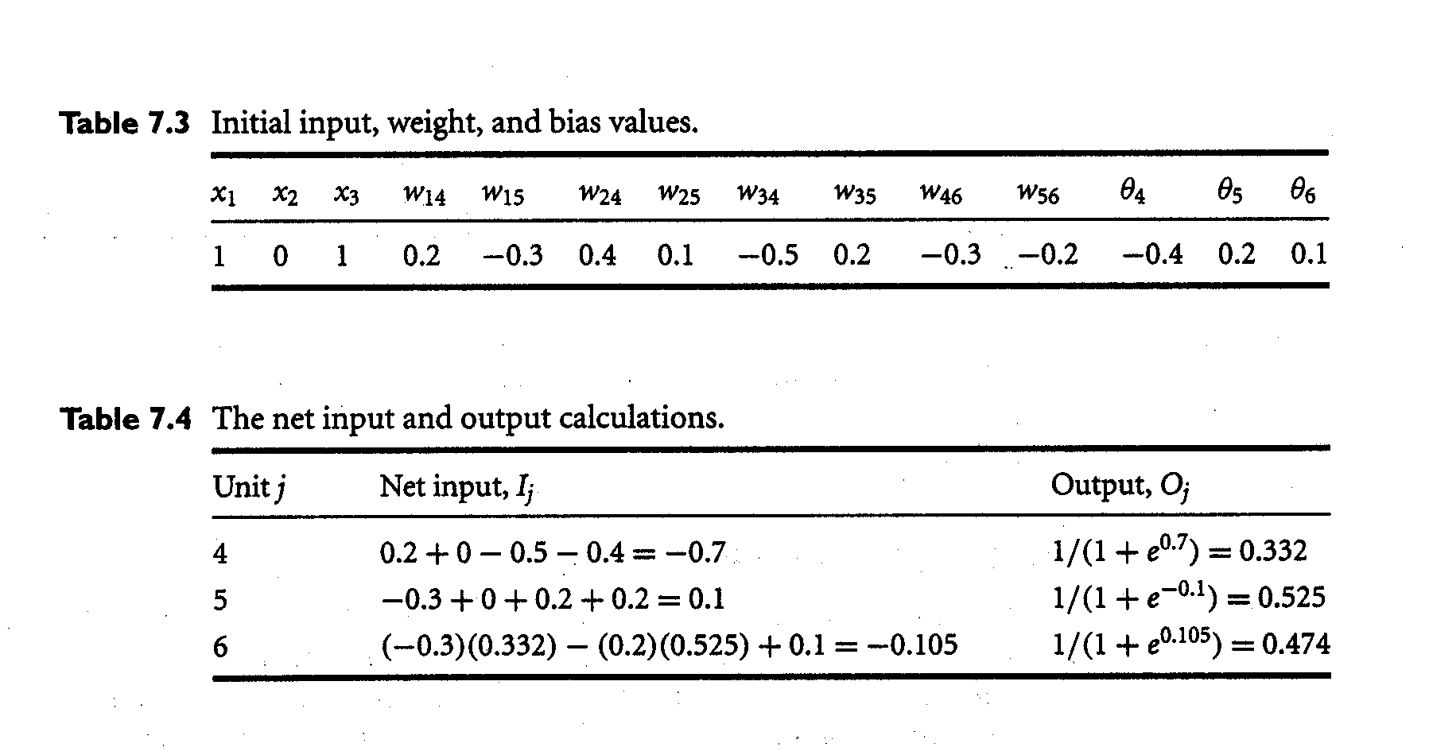

Slide 91
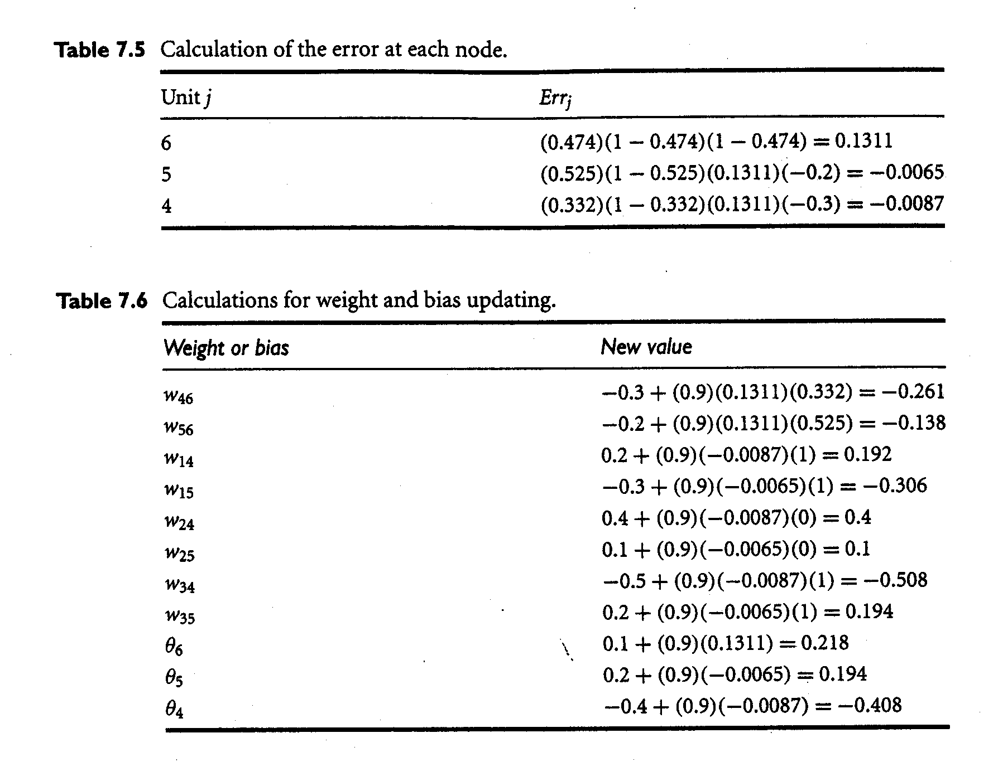

Slide 92
Terminating condition
All Δw_{ij} in the previous epoch were so small as to be below some specified threshold, or
The percentage of samples misclassified in the previous epoch is below some threshold, or
A prespecified number of epochs has expired.
In practice, several hundreds of thousands of epochs may be required before the weights will converge.

Slide 94
How A Multi-Layer Neural Network Works?
The inputs to the network correspond to the attributes measured for each training tuple
Inputs are fed simultaneously into the units making up the input layer
They are then weighted and fed simultaneously to a hidden layer
The number of hidden layers is arbitrary, although usually only one
The weighted outputs of the last hidden layer are input to units making up the output layer, which emits the network's prediction
The network is feed-forward in that none of the weights cycles back to an input unit or to an output unit of a previous layer
From a statistical point of view, networks perform nonlinear regression: Given enough hidden units and enough training samples, they can closely approximate any function

Slide 95
Defining a Network Topology
First decide the network topology: # of units in the input layer, # of hidden layers (if > 1), # of units in each hidden layer, and # of units in the output layer
Normalizing the input values for each attribute measured in the training tuples to [0.0—1.0]
One input unit per domain value, each initialized to 0
Output, if for classification and more than two classes, one output unit per class is used
Once a network has been trained and its accuracy is unacceptable, repeat the training process with a different network topology or a different set of initial weights

Slide 96
Backpropagation
Iteratively process a set of training tuples & compare the network's prediction with the actual known target value
For each training tuple, the weights are modified to minimize the mean squared error between the network's prediction and the actual target value
Modifications are made in the “backwards” direction: from the output layer, through each hidden layer down to the first hidden layer, hence “backpropagation”
Steps
Initialize weights (to small random #s) and biases in the network
Propagate the inputs forward (by applying activation function)
Backpropagate the error (by updating weights and biases)
Terminating condition (when error is very small, etc.)

Slide 97
Backpropagation and Interpretability
Efficiency of backpropagation: Each epoch (one interation through the training set) takes O(|D| * w), with |D| tuples and w weights, but # of epochs can be exponential to n, the number of inputs, in the worst case
Rule extraction from networks: network pruning
Simplify the network structure by removing weighted links that have the least effect on the trained network
Then perform link, unit, or activation value clustering
The set of input and activation values are studied to derive rules describing the relationship between the input and hidden unit layers
Sensitivity analysis: assess the impact that a given input variable has on a network output. The knowledge gained from this analysis can be represented in rules

Slide 98
Chapter 6. Classification and Prediction
What is classification? What is prediction?
Issues regarding classification and prediction
Classification by decision tree induction
Bayesian classification
Rule-based classification
Classification by back propagation
Support Vector Machines (SVM)
Associative classification
Lazy learners (or learning from your neighbors)
Other classification methods
Prediction
Accuracy and error measures
Ensemble methods
Model selection
Summary

Slide 99
The k-Nearest Neighbor Algorithm
All instances correspond to points in the n-D space
The nearest neighbor are defined in terms of Euclidean distance, dist(X₁, X₂)
Target function could be discrete- or real- valued
For discrete-valued, k-NN returns the most common value among the k training examples nearest to x_{q}
Vonoroi diagram: the decision surface induced by 1-NN for a typical set of training examples
_
.
_
_
.
+
_
.
+
.
.
_
x_{q}
+
_
.
+

Slide 100
Discussion on the k-NN Algorithm
k-NN for real-valued prediction for a given unknown tuple
Returns the mean values of the k nearest neighbors
Distance-weighted nearest neighbor algorithm
Weight the contribution of each of the k neighbors according to their distance to the query x_{q}
Give greater weight to closer neighbors
Robust to noisy data by averaging k-nearest neighbors
Curse of dimensionality: distance between neighbors could be dominated by irrelevant attributes
To overcome it, axes stretch or elimination of the least relevant attributes

Slide 101
Chapter 6. Classification and Prediction
What is classification? What is prediction?
Issues regarding classification and prediction
Classification by decision tree induction
Bayesian classification
Rule-based classification
Classification by back propagation
Support Vector Machines (SVM)
Associative classification
Lazy learners (or learning from your neighbors)
Other classification methods
Prediction
Accuracy and error measures
Ensemble methods
Model selection
Summary

Slide 102
What Is Prediction?
(Numerical) prediction is similar to classification
construct a model
use model to predict continuous or ordered value for a given input
Prediction is different from classification
Classification refers to predict categorical class label
Prediction models continuous-valued functions
Major method for prediction: regression
model the relationship between one or more independent or predictor variables and a dependent or response variable
Regression analysis
Linear and multiple regression
Non-linear regression
Other regression methods: generalized linear model, Poisson regression, log-linear models, regression trees

Slide 103
Linear Regression
Linear regression: involves a response variable y and a single predictor variable x
y = w₀ + w₁ x
where w₀ (y-intercept) and w₁ (slope) are regression coefficients
Method of least squares: estimates the best-fitting straight line
Multiple linear regression: involves more than one predictor variable
Training data is of the form (X₁, y₁), (X₂, y₂),…, (X_{|D|}, y_{|D|})
Ex. For 2-D data, we may have: y = w₀ + w₁ x₁+ w₂ x₂
Solvable by extension of least square method or using SAS, S-Plus
Many nonlinear functions can be transformed into the above

Slide 104
Nonlinear Regression
Some nonlinear models can be modeled by a polynomial function
A polynomial regression model can be transformed into linear regression model. For example,
y = w₀ + w₁ x + w₂ x² + w₃ x³
convertible to linear with new variables: x₂ = x², x₃= x³
y = w₀ + w₁ x + w₂ x₂ + w₃ x₃
Other functions, such as power function, can also be transformed to linear model
Some models are intractable nonlinear (e.g., sum of exponential terms)
possible to obtain least square estimates through extensive calculation on more complex formulae

Slide 105
Other Regression-Based Models
Generalized linear model:
Foundation on which linear regression can be applied to modeling categorical response variables
Variance of y is a function of the mean value of y, not a constant
Logistic regression: models the prob. of some event occurring as a linear function of a set of predictor variables
Poisson regression: models the data that exhibit a Poisson distribution
Log-linear models: (for categorical data)
Approximate discrete multidimensional prob. distributions
Also useful for data compression and smoothing
Regression trees and model trees
Trees to predict continuous values rather than class labels

Slide 106
Chapter 6. Classification and Prediction
What is classification? What is prediction?
Issues regarding classification and prediction
Classification by decision tree induction
Bayesian classification
Rule-based classification
Classification by back propagation
Support Vector Machines (SVM)
Associative classification
Lazy learners (or learning from your neighbors)
Other classification methods
Prediction
Accuracy and error measures
Ensemble methods
Model selection
Summary

Slide 107
Classifier Accuracy Measures
 | C₁ | C₂
C₁ | True positive | False negative
C₂ | False positive | True negative
classes | buy_computer = yes | buy_computer = no | total | recognition(%)
buy_computer = yes | 6954 | 46 | 7000 | 99.34
buy_computer = no | 412 | 2588 | 3000 | 86.27
total | 7366 | 2634 | 10000 | 95.52
Accuracy of a classifier M, acc(M): percentage of test set tuples that are correctly classified by the model M
Error rate (misclassification rate) of M = 1 – acc(M)
Given m classes, CM_{i,j}, an entry in a confusion matrix, indicates # of tuples in class i that are labeled by the classifier as class j
Alternative accuracy measures (e.g., for cancer diagnosis)
sensitivity = t-pos/pos /* true positive recognition rate */
specificity = t-neg/neg /* true negative recognition rate */
precision = t-pos/(t-pos + f-pos)
accuracy = sensitivity * pos/(pos + neg) + specificity * neg/(pos + neg)
This model can also be used for cost-benefit analysis

Slide 108
Predictor Error Measures
Measure predictor accuracy: measure how far off the predicted value is from the actual known value
Loss function: measures the error betw. y_{i} and the predicted value y_{i}’
Absolute error: | y_{i} – y_{i}’|
Squared error: (y_{i} – y_{i}’)²
Test error (generalization error): the average loss over the test set
Mean absolute error: Mean squared error:
Relative absolute error: Relative squared error:
The mean squared-error exaggerates the presence of outliers
Popularly use (square) root mean-square error, similarly, root relative squared error

Slide 109
Evaluating the Accuracy of a Classifier or Predictor (I)
Holdout method
Given data is randomly partitioned into two independent sets
Training set (e.g., 2/3) for model construction
Test set (e.g., 1/3) for accuracy estimation
Random sampling: a variation of holdout
Repeat holdout k times, accuracy = avg. of the accuracies obtained
Cross-validation (k-fold, where k = 10 is most popular)
Randomly partition the data into k mutually exclusive subsets, each approximately equal size
At i-th iteration, use D_{i} as test set and others as training set
Leave-one-out: k folds where k = # of tuples, for small sized data
Stratified cross-validation: folds are stratified so that class dist. in each fold is approx. the same as that in the initial data

Slide 110
Chapter 6. Classification and Prediction
What is classification? What is prediction?
Issues regarding classification and prediction
Classification by decision tree induction
Bayesian classification
Rule-based classification
Classification by back propagation
Support Vector Machines (SVM)
Associative classification
Lazy learners (or learning from your neighbors)
Other classification methods
Prediction
Accuracy and error measures
Ensemble methods
Model selection
Summary

Slide 111
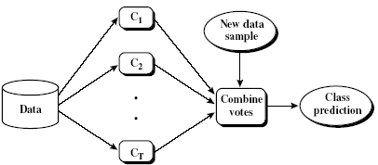
Ensemble Methods: Increasing the Accuracy
Ensemble methods
Use a combination of models to increase accuracy
Combine a series of k learned models, M₁, M₂, …, M_{k}, with the aim of creating an improved model M*
Popular ensemble methods
Bagging: averaging the prediction over a collection of classifiers
Boosting: weighted vote with a collection of classifiers
Ensemble: combining a set of heterogeneous classifiers

Slide 112
General Idea

Slide 113
Why does it work?
Suppose there are 25 base classifiers
Each classifier has error rate, ε = 0.35
Assume classifiers are independent
Probability that the ensemble classifier makes a wrong prediction:

Slide 114
Bagging: Boostrap Aggregation
Analogy: Diagnosis based on multiple doctors’ majority vote
Training
Given a set D of d tuples, at each iteration i, a training set D_{i} of d tuples is sampled with replacement from D (i.e., boostrap)
A classifier model M_{i} is learned for each training set D_{i}
Classification: classify an unknown sample X
Each classifier M_{i} returns its class prediction
The bagged classifier M* counts the votes and assigns the class with the most votes to X
Prediction: can be applied to the prediction of continuous values by taking the average value of each prediction for a given test tuple
Accuracy
Often significant better than a single classifier derived from D
For noise data: not considerably worse, more robust
Proved improved accuracy in prediction

Slide 115
Boosting
Analogy: Consult several doctors, based on a combination of weighted diagnoses—weight assigned based on the previous diagnosis accuracy
How boosting works?
Weights are assigned to each training tuple
A series of k classifiers is iteratively learned
After a classifier M_{i} is learned, the weights are updated to allow the subsequent classifier, M_{i+1}, to pay more attention to the training tuples that were misclassified by M_{i}
The final M* combines the votes of each individual classifier, where the weight of each classifier's vote is a function of its accuracy
The boosting algorithm can be extended for the prediction of continuous values
Comparing with bagging: boosting tends to achieve greater accuracy, but it also risks overfitting the model to misclassified data

Slide 116
Adaboost (Freund and Schapire, 1997)
Given a set of d class-labeled tuples, (X₁, y₁), …, (X_{d}, y_{d})
Initially, all the weights of tuples are set the same (1/d)
Generate k classifiers in k rounds. At round i,
Tuples from D are sampled (with replacement) to form a training set D_{i} of the same size
Each tuple’s chance of being selected is based on its weight
A classification model M_{i} is derived from D_{i}
Its error rate is calculated using D_{i} as a test set
If a tuple is misclssified, its weight is increased, o.w. it is decreased
Error rate: err(X_{j}) is the misclassification error of tuple X_{j}. Classifier M_{i} error rate is the sum of the weights of the misclassified tuples:
The weight of classifier M_{i}’s vote is

Slide 117
Notation
Input:
D, a set of d class-labeled training tuples;
K, the number of rounds (one classifier is generated per round);
A classification learning scheme.

Slide 118
Adaboost
Output: A composite model
(1) Initialize the weight of each tuple in D to i/d;
(2) for i=1 to k do // for each round
(3) sample D with replacement according to the tuple weights to obtain D_{i};
(4) use training set D_{i} to derive a model, M_{i};
(5) compute error(M_{i}), the error rate of M_{i}
(6) if error(M_{i}) > 0.5 then
(7) reinitialize the weight to 1/d
(8) go back to step 3 and try again;
(9) endif
(10) for each tuple in D_{i} that was correctly classified do
(11) multiply the weight of the tuple by error(M_{i})/(1-error(M_{i}));
(12) normalize the weight of each tuple;
(13) endfor

Slide 119
To calssify tuple X
Initialize weight of each class to 0;
For i=1 to k do //for each classifier:
w_{i}= ;// weight of the classifier’s vote
c=M_{i}(X);// get class prediction for X from M_{i}
add w_{i} to weight for class c
Endfor
Return the class with the largest weight;

Slide 120
Decision tree regression
gradient-boosting-explained
End-to-end boosting
Math-in-gradient-boosting
Battle between random forest and gradient boosting
Explained-in-Chinese
Decision tree for regression

Slide 121
Chapter 6. Classification and Prediction
What is classification? What is prediction?
Issues regarding classification and prediction
Classification by decision tree induction
Bayesian classification
Rule-based classification
Classification by back propagation
Support Vector Machines (SVM)
Associative classification
Lazy learners (or learning from your neighbors)
Other classification methods
Prediction
Accuracy and error measures
Ensemble methods
Model selection
Summary

Slide 122
Model Evaluation
Metrics for Performance Evaluation
How to evaluate the performance of a model?
Methods for Performance Evaluation
How to obtain reliable estimates?
Methods for Model Comparison
How to compare the relative performance among competing models?

Slide 123
Model Evaluation
Metrics for Performance Evaluation
How to evaluate the performance of a model?
Methods for Performance Evaluation
How to obtain reliable estimates?
Methods for Model Comparison
How to compare the relative performance among competing models?

Slide 124
Metrics for Performance Evaluation
Focus on the predictive capability of a model
Rather than how fast it takes to classify or build models, scalability, etc.
Confusion Matrix:
 | PREDICTED CLASS
ACTUAL CLASS |  | Class=Yes | Class=No
 | Class=Yes | a | b
 | Class=No | c | d
a: TP (true positive)
b: FN (false negative)
c: FP (false positive)
d: TN (true negative)

Slide 125
Metrics for Performance Evaluation
 | PREDICTED CLASS
ACTUAL CLASS |  | Class=Yes | Class=No
 | Class=Yes | a (TP) | b (FN)
 | Class=No | c (FP) | d (TN)
Most widely-used metric:

Slide 126
Limitation of Accuracy
Consider a 2-class problem
Number of Class 0 examples = 9990
Number of Class 1 examples = 10
If model predicts everything to be class 0, accuracy is 9990/10000 = 99.9 %
Accuracy is misleading because model does not detect any class 1 example

Slide 127
Cost Matrix
 | PREDICTED CLASS
ACTUAL CLASS | C(i|j) | Class=Yes | Class=No
 | Class=Yes | C(Yes|Yes) | C(No|Yes)
 | Class=No | C(Yes|No) | C(No|No)
C(i|j): Cost of misclassifying class j example as class i

Slide 128
Computing Cost of Classification
Cost Matrix | PREDICTED CLASS
ACTUAL CLASS | C(i|j) | + | -
 | + | -1 | 100
 | - | 1 | 0
Model M₁ | PREDICTED CLASS
ACTUAL CLASS |  | + | -
 | + | 150 | 40
 | - | 60 | 250
Model M₂ | PREDICTED CLASS
ACTUAL CLASS |  | + | -
 | + | 250 | 45
 | - | 5 | 200
Accuracy = 80%
Cost = 3910
Accuracy = 90%
Cost = 4255

Slide 129
Cost vs Accuracy
Count | PREDICTED CLASS
ACTUAL CLASS |  | Class=Yes | Class=No
 | Class=Yes | a | b
 | Class=No | c | d
Accuracy is proportional to cost if 1. C(Yes|No)=C(No|Yes) = q 2. C(Yes|Yes)=C(No|No) = p
N = a + b + c + d
Accuracy = (a + d)/N
Cost = p (a + d) + q (b + c)
= p (a + d) + q (N – a – d)
= q N – (q – p)(a + d)
= N [q – (q-p) × Accuracy]
Cost | PREDICTED CLASS
ACTUAL CLASS |  | Class=Yes | Class=No
 | Class=Yes | p | q
 | Class=No | q | p

Slide 130
F Measures
Low values of  make F closer to p; high values make it closer to r
=2 gives more weight to r;
=1 gives equal weight to r and p;
=1/2 gives more weight to p.

Slide 131
Different means
Three different means: arithmetic, geometric and harmonic
For a=1, b=5; arithmetic mean= (a+b)/2 =3
Geometric mean = (a*b)^{1/2}=2.236
Harmonic mean =
=5/3 =1.667
Which is closer to the smaller one; so if F1 is larger, both the p and r will be large

Slide 132
Model Evaluation
Metrics for Performance Evaluation
How to evaluate the performance of a model?
Methods for Performance Evaluation
How to obtain reliable estimates?
Methods for Model Comparison
How to compare the relative performance among competing models?

Slide 133
Methods for Performance Evaluation
How to obtain a reliable estimate of performance?
Performance of a model may depend on other factors besides the learning algorithm:
Class distribution
Cost of misclassification
Size of training and test sets

Slide 134
Methods of Estimation
Holdout
Reserve 2/3 for training and 1/3 for testing
Random subsampling
Repeated holdout
Cross validation
Partition data into k disjoint subsets
k-fold: train on k-1 partitions, test on the remaining one
Leave-one-out: k=n
Stratified sampling
oversampling vs undersampling
Bootstrap
Sampling with replacement

Slide 135
Model Evaluation
Metrics for Performance Evaluation
How to evaluate the performance of a model?
Methods for Performance Evaluation
How to obtain reliable estimates?
Methods for Model Comparison
How to compare the relative performance among competing models? Which model is better?

Slide 136
ROC (Receiver Operating Characteristic)
Developed in 1950s for signal detection theory to analyze noisy signals
Characterize the trade-off between positive hits(TP) and false alarms (FP)
ROC curve plots TP (on the y-axis) against FP (on the x-axis)
Performance of each classifier represented as a point on the ROC curve
changing the threshold of algorithm, sample distribution or cost matrix changes the location of the point

Slide 137
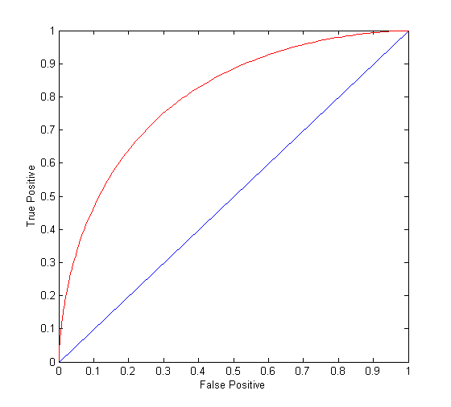
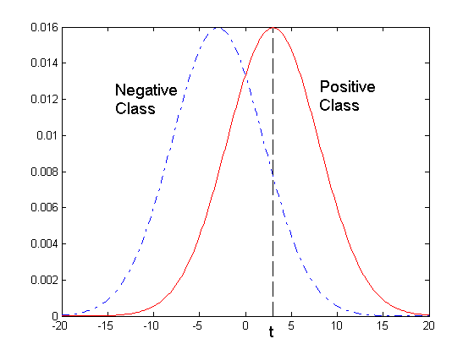
ROC Curve
- 1-dimensional data set containing 2 classes (positive and negative)
- any points located at x > t is classified as positive
At threshold t:
TP=0.5, FN=0.5, FP=0.12, TN=0.88

Slide 138
ROC Curve
(TPR,FPR):
(0,0): predict everything to be a negative class
(1,1): predict everything to be a positive class
(1,0): the ideal model
Diagonal line:
Random guessing
Below diagonal line:
prediction is opposite of the true class
TP rate, TPR = TP/(TP+FN)
FP rate, FPR = FP/(FP + TN)

Slide 139
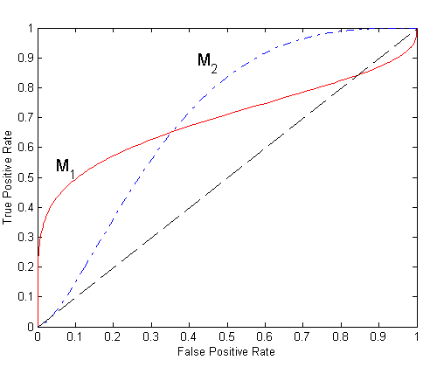
Using ROC for Model Comparison
No model consistently outperform the other
M₁ is better for small FPR
M₂ is better for large FPR
Area Under the ROC curve (AUC)
Ideal:
Area = 1
Random guess:
Area = 0.5

Slide 140
How to Construct an ROC curve
Use classifier that produces posterior probability for each test instance P(+|A)
Sort the instances according to P(+|A) in decreasing order
Apply threshold at each unique value of P(+|A)
Count the number of TP, FP, TN, FN at each threshold
TP rate, TPR = TP/(TP+FN)
FP rate, FPR = FP/(FP + TN)
Instance | P(+|A) | True Class
1 | 0.95 | +
2 | 0.93 | +
3 | 0.87 | -
4 | 0.85 | -
5 | 0.85 | -
6 | 0.85 | +
7 | 0.76 | -
8 | 0.53 | +
9 | 0.43 | -
10 | 0.25 | +

Slide 141
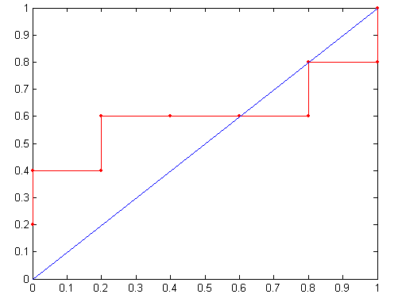
How to construct an ROC curve
Threshold >=
TPR = TP/(TP+FN)
ROC Curve:
FPR = FP/(FP + TN)

Slide 142
How to construct an ROC curve
Threshold >=
TPR = TP/(TP+FN)
ROC Curve:
FPR = FP/(FP + TN)

Slide 143
A random guess
TP rate, TPR = TP/(TP+FN)
FP rate, FPR = FP/(FP + TN)
Random guessing means that a record is classified
as a positive class with a fixed probability p,
irrespective of its attribute set.
Consider a data set that contains n₊ positive
instances and n₋ negative instances.
Correctly classified positive instances: p* n₊
Misclassified negative instances: p* n₋
TPR=(p*n₊)/n₊=p ; FPR=(p*n₋)/n₋=p
Corresponds to a point on the ROC curve; p=0 the (0,0)
Case; p=1 the (1,1) case.

Slide 144
Each point along the ROC curve of a classifier corresponds to one of the models induced by the classifier.
AUC(Area under curve): The area under the ROC Curve; better as it is close to 1
A classifier is better than the other if it’s AUC is larger than that of the other
Gini index: ratio of the area in between the ROC curve and diagonal line over the area in between the perfect ROC curve and the diagonal line
Gini = 2AUC-1

Slide 145
AUC | Gini index | Model performance
<=0.5 | 0 | bad
0.5-0.7 | 0.0-0.4 | Not acceptable
0.7-0.8 | 0.4-0.6 | acceptable
0.8-0.9 | 0.6-0.8 | good
0.9-1.0 | 0.8-1.0 | Very good (over fitting?)

Slide 146
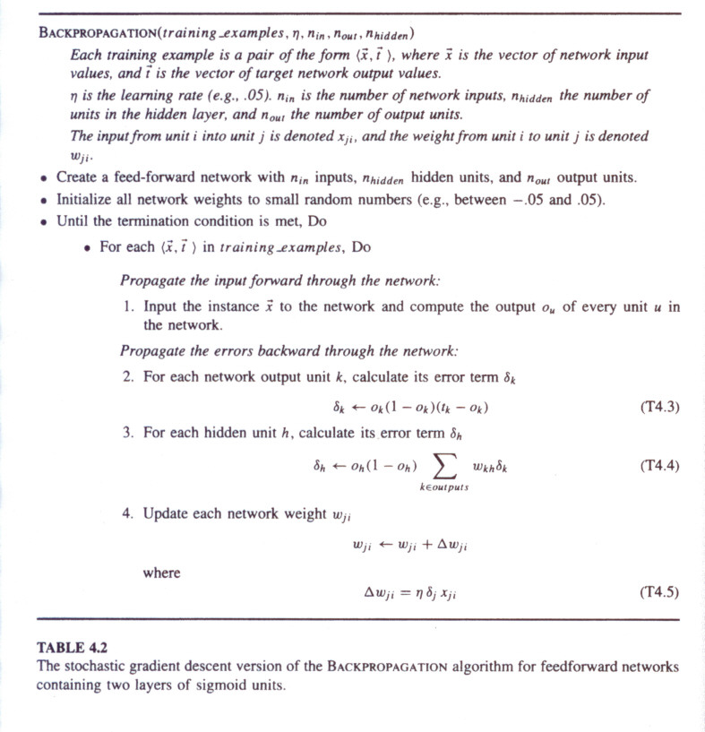

Slide 147


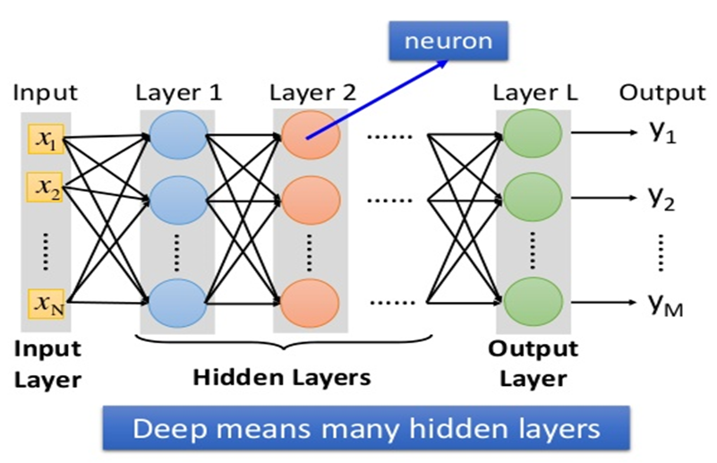

Fully connect Freed Forward Network Deep Neural Network -- Ө
w
b
w
W
W
W
a1⁰
a2⁰
a3⁰
an⁰
Y1^
loss
Y2^
B
B
B
L
b1⁰
b2⁰
b3⁰
bn⁰
YM^
L
b
正向餵資料，反向傳遞修正模型，測試模型可用性，使用

